Slide 1

Build-your-own Microcontroller Sensor Workshop

Slide 2

Build-your-own Microcontroller Sensor Workshop
https://github.com/snguyen1/microcontroller-workshop-1

Slide 3
What are we going to do?
Learn about microcontrollers
Learn about sensors
Little bit about electronics
Try to build temperature sensing circuit
Program a microcontroller

Slide 4
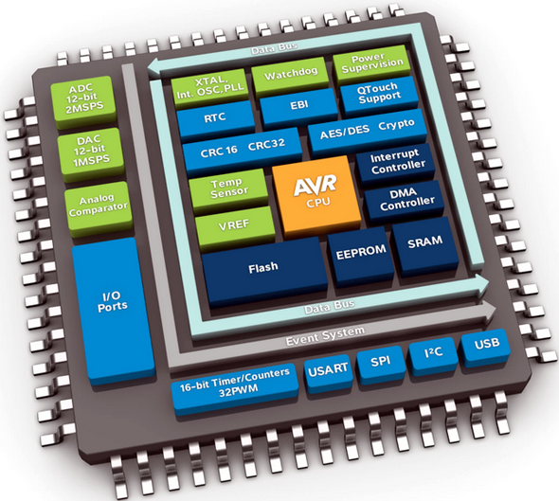
About Microcontrollers
A small computer all in one chip
Has built-in:
CPU
Memory and Storage
Some have WiFi or Bluetooth
Communicates by using input/output pins
Uses common communication protocols
Has various power needs
Common is 5 volts or 3.3 volts

Slide 5
About Sensors
Power needs
Digital VS. Analog
Protocols (I2C, SPI, “Serial”, others)
What is VCC, VDD, VIN, CLK and other labels you might find

Slide 6
Power needs
Common Voltages
5 volts
3.3 volts
1.5, 1.8, 2.5, 2.85 volts
12 volts, -5.2 volts (ECL)
Logic Voltage
TTL (Transistor to Transistor Logic)
Uses 5 volts - i.e. 5v = on (1), and 0v = off (0)
CMOS (Complementary metal–oxide–semiconductor)
Uses supply voltage (i.e. 3.3 volts)

Slide 7
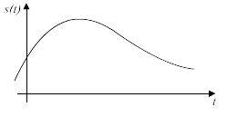
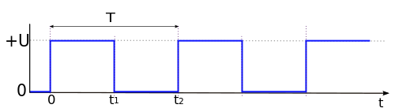
Analog VS Digital
Analog
Variable values
Easy to translate
Can only send one value
Digital
On or Off (1 or 0)
Can send data easily
Could send multiple values (messages)

Slide 8
Common Communication Protocols
I²C - Inter-Integrated Circuit
SPI - Serial Peripheral Interface
Serial - RS-232
TTL - Transistor to Transistor Logic
USB - Universal Serial Bus
CAN bus - Controlled Area Network
1-Wire
Wireless

Slide 9
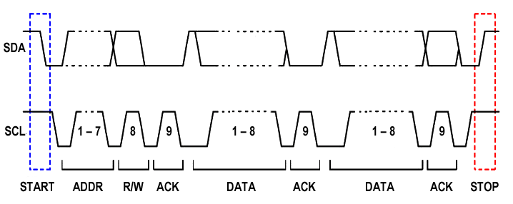
Common Communication Protocols
I²C - Inter-Integrated Circuit
Known as I-two-C, or I-Squared-C
Can send data pretty fast
Talks over two lines/wires
SDA - Serial Data
SCL - Serial Clock
Multiple devices can talk at the same over the same wires

Slide 10
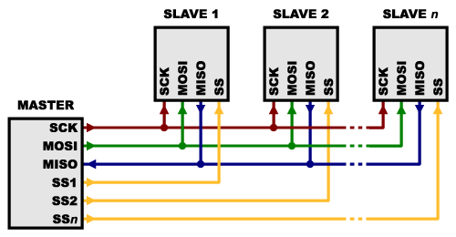
Common Communication Protocols
SPI - Serial Peripheral Interface
Can send data pretty fast
Multiple devices can talk over the same wires
Talks over four lines/wires
MOSI - Master Out Slave In
MISO - Mast In Slave Out
SCK - Serial Clock
SS1..SSn - Slave Select

Slide 11
Common Pin Labels
VCC, VIN, V+, 5V, 3V3
Supply voltage (usually 5 volts, or 3.3 volts.)
GND
Ground or “negative” terminal
GPIO, D1..Dxx, A1..Axx
General Purpose IO, Digital in/out, Analog in/out
SCK, SDA, MISO, MOSI, CS, SS
Common communication protocol pins
CLK, ADC, DAC, HSPI, RTC, TOUCH

Slide 12
Equipment
Notes:
Let’s look at our parts.

Slide 13
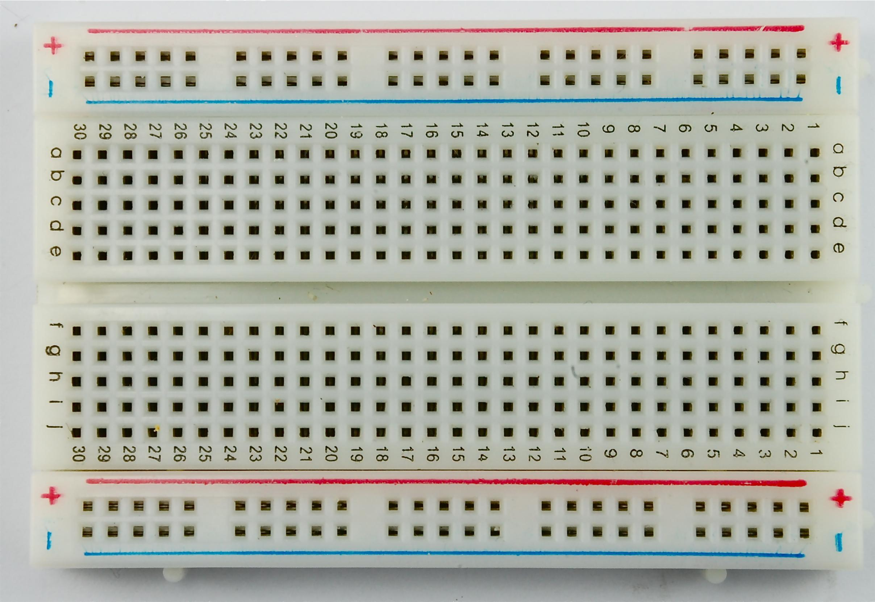
Breadboard
Half-size Breadboard
Easy to use
Quick prototyping
Reusable
No Soldering
Notes:
Breadboard layout.

Slide 14
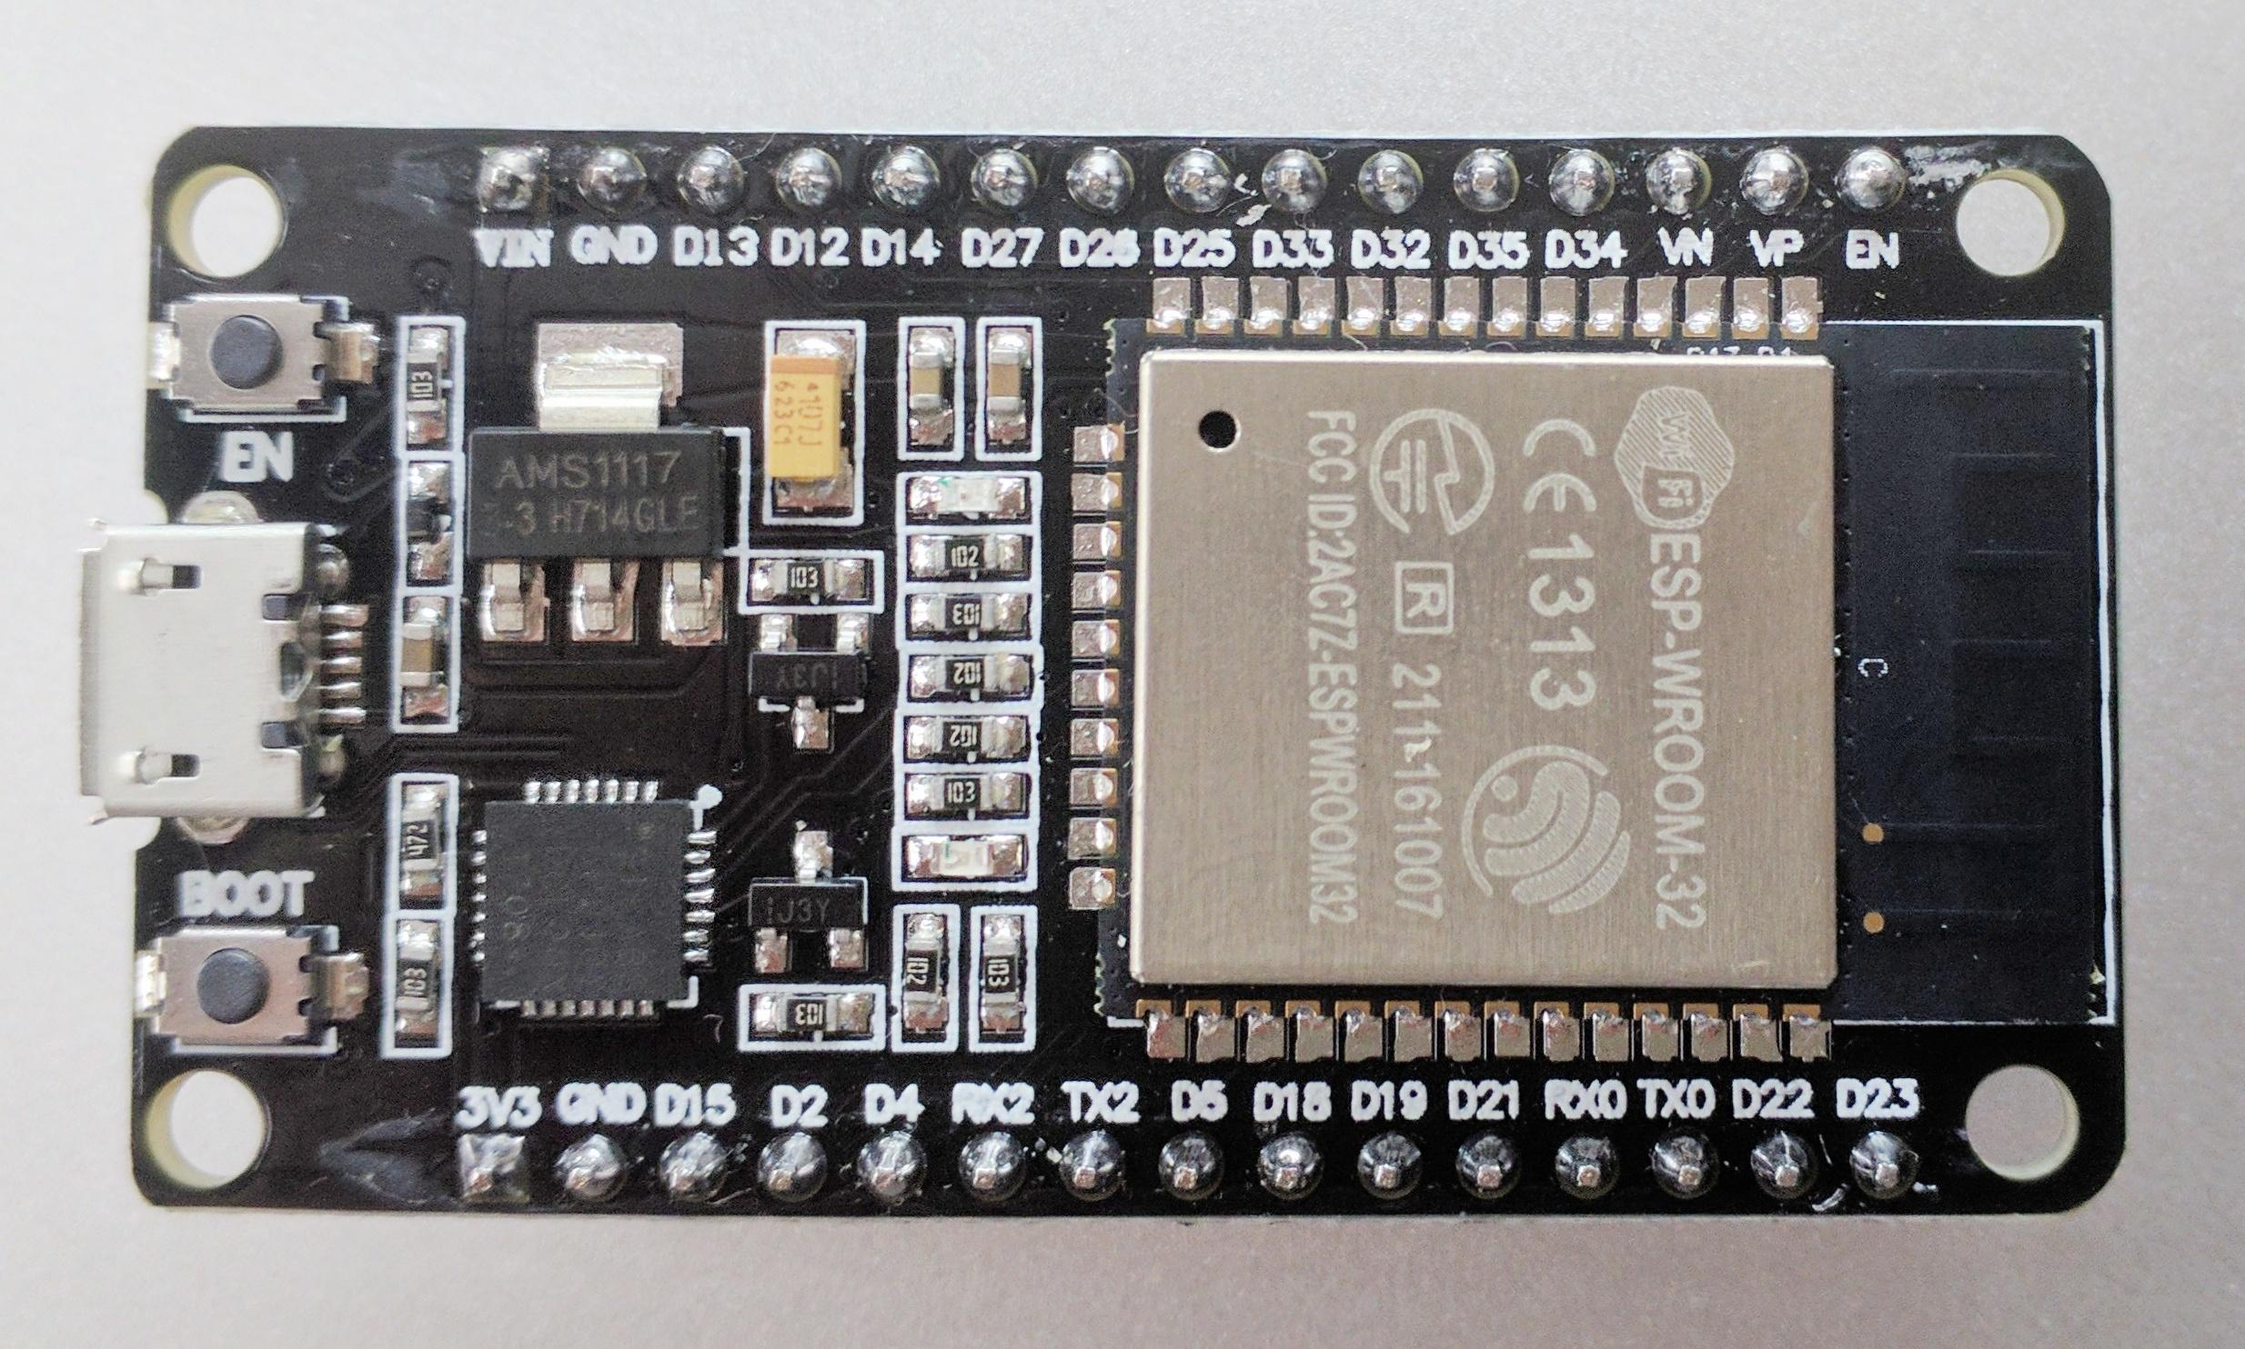
Microcontroller Development Board
ESP32
Built-in Wireless
Many General Purpose I/O pins
Well established
Inexpensive
Readily Available
Notes:
What is a microcontroller? It is a small computer that can communicate through pins on the board. Sometimes it’s a simple signal, like on or off. But it there are also more complex signals like serial data. There are several microcontrollers, we are are going to use this one.

Slide 15
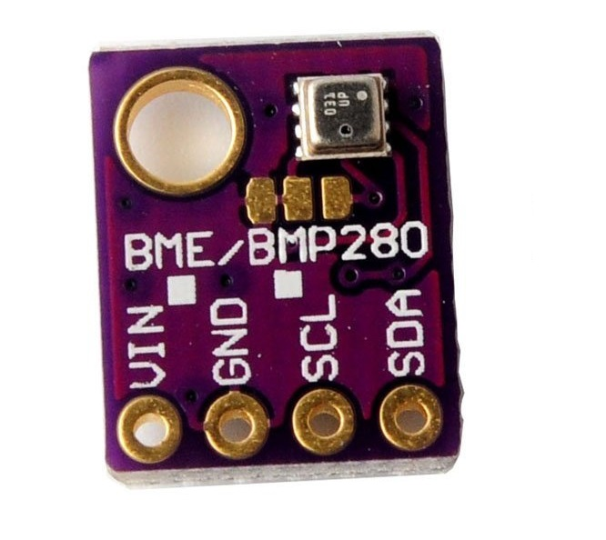
Environment Sensor
Bosch BME280
Low voltage (1.71V to 3.6V)
Temperature Range 0°C to 65°C
Measure Relative Humidity
Pressure from 300-1100 kPa
Accurate ±1°C
Low power consumption
Very small 2.5x2.5mm
Using I2C
Notes:
But we are going to use this Bosch BME280 sensor. Which can measure temperature, humidity and pressure all at once, and as you can see it’s very small.

Slide 16
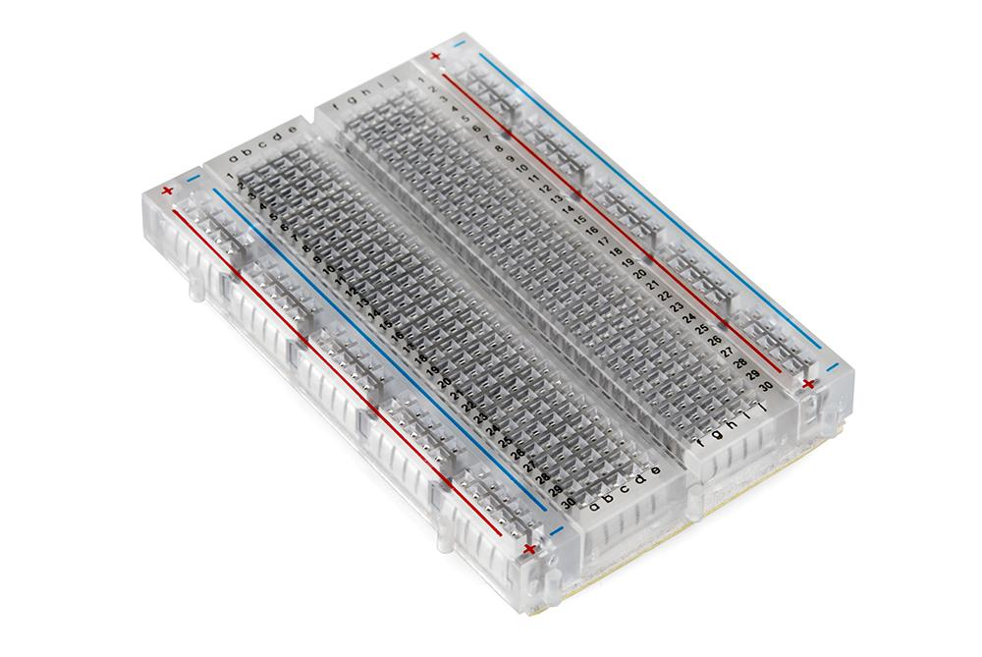
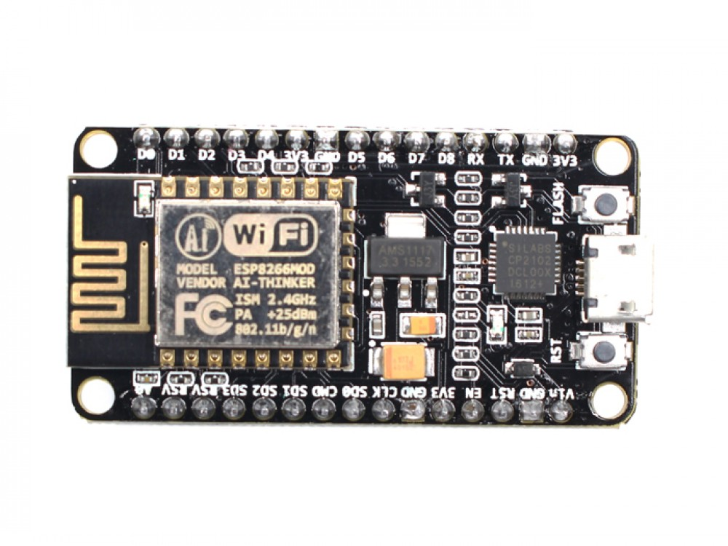
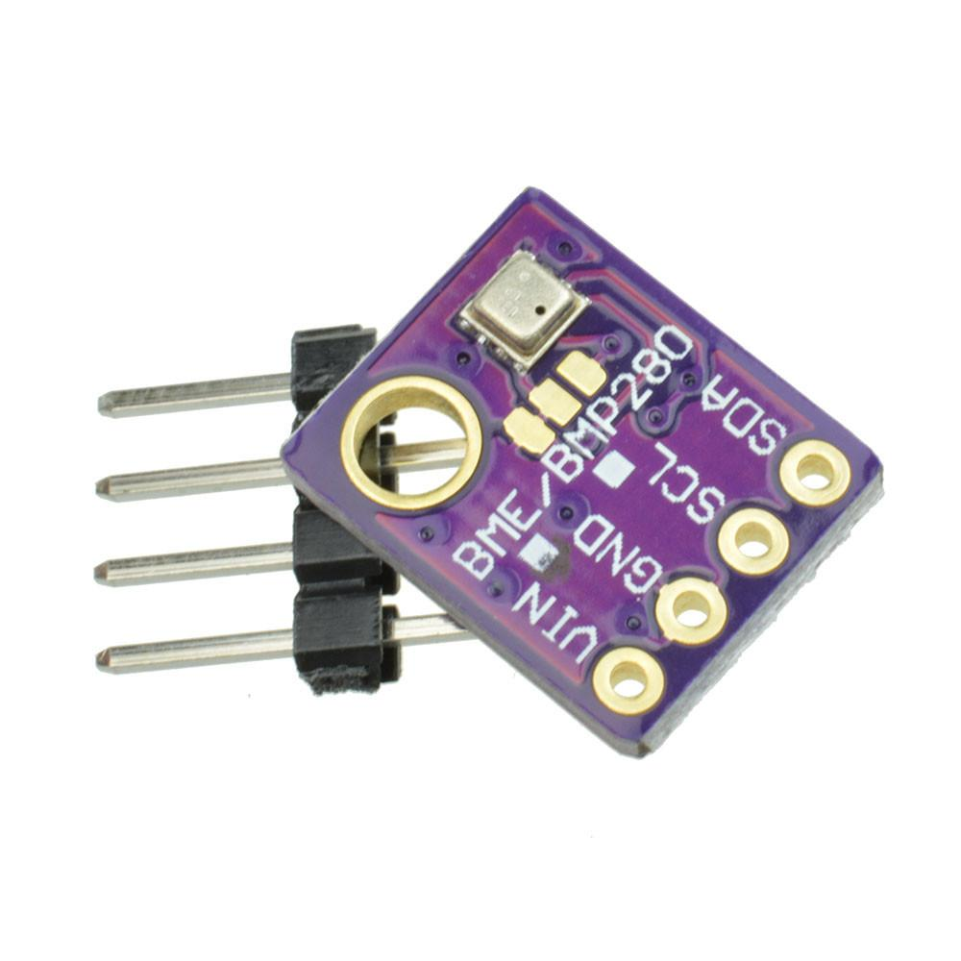
Putting it together
Notes:
We are going to do this in three steps, first we add the temperature sensor, then add the clock, then the sd card. And test each step so we know it works.

Slide 17
Lesson 1
Notes:
Next we need to program the microcontroller

Slide 18
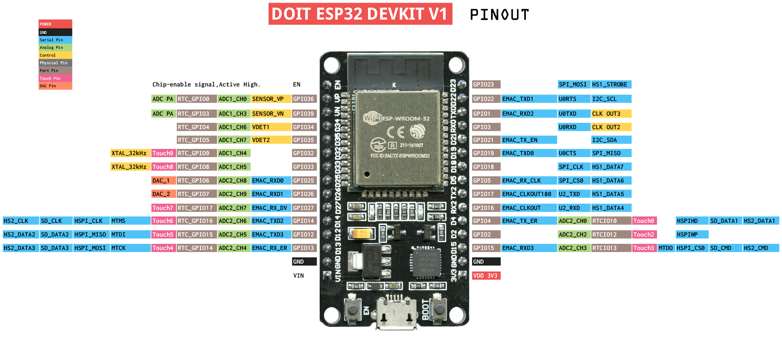
Microcontroller Pinout

Slide 19
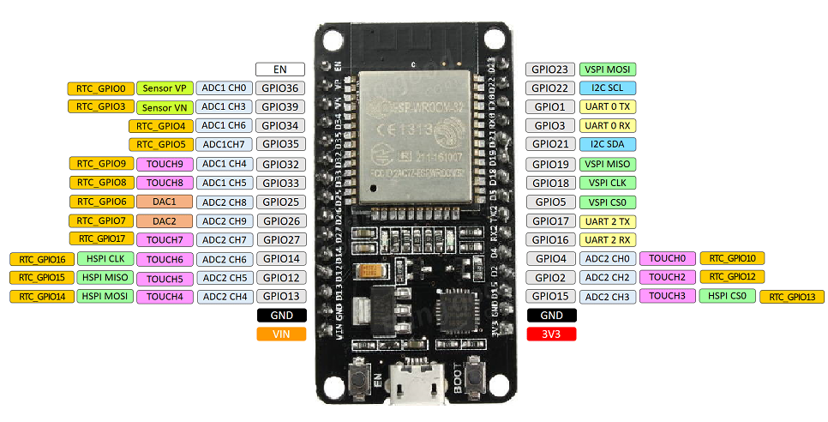
Microcontroller Pinout

Slide 20
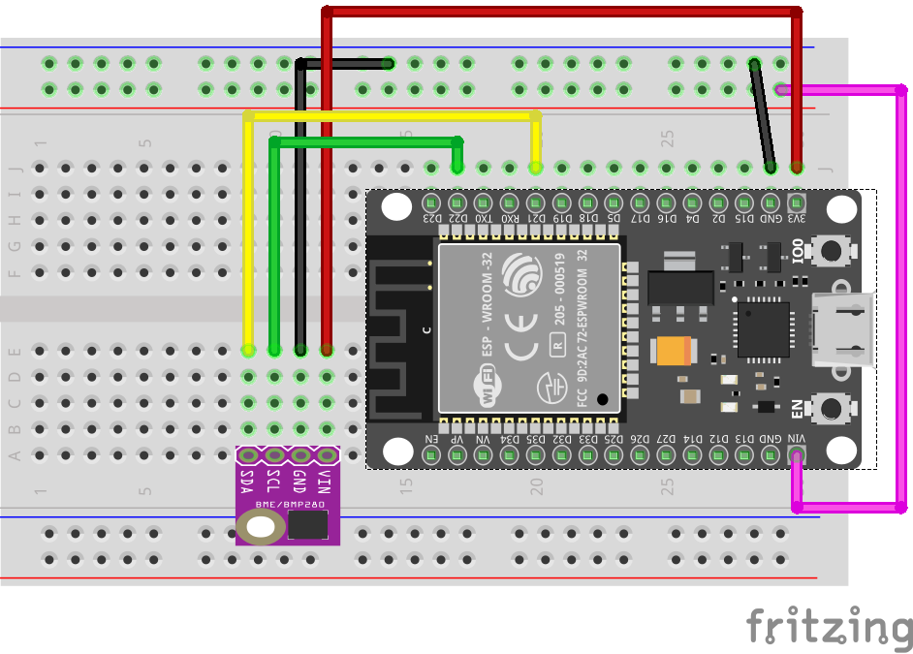
Add the Sensor

Slide 21
Program the Microcontroller
Notes:
Next we need to program the microcontroller

Slide 22
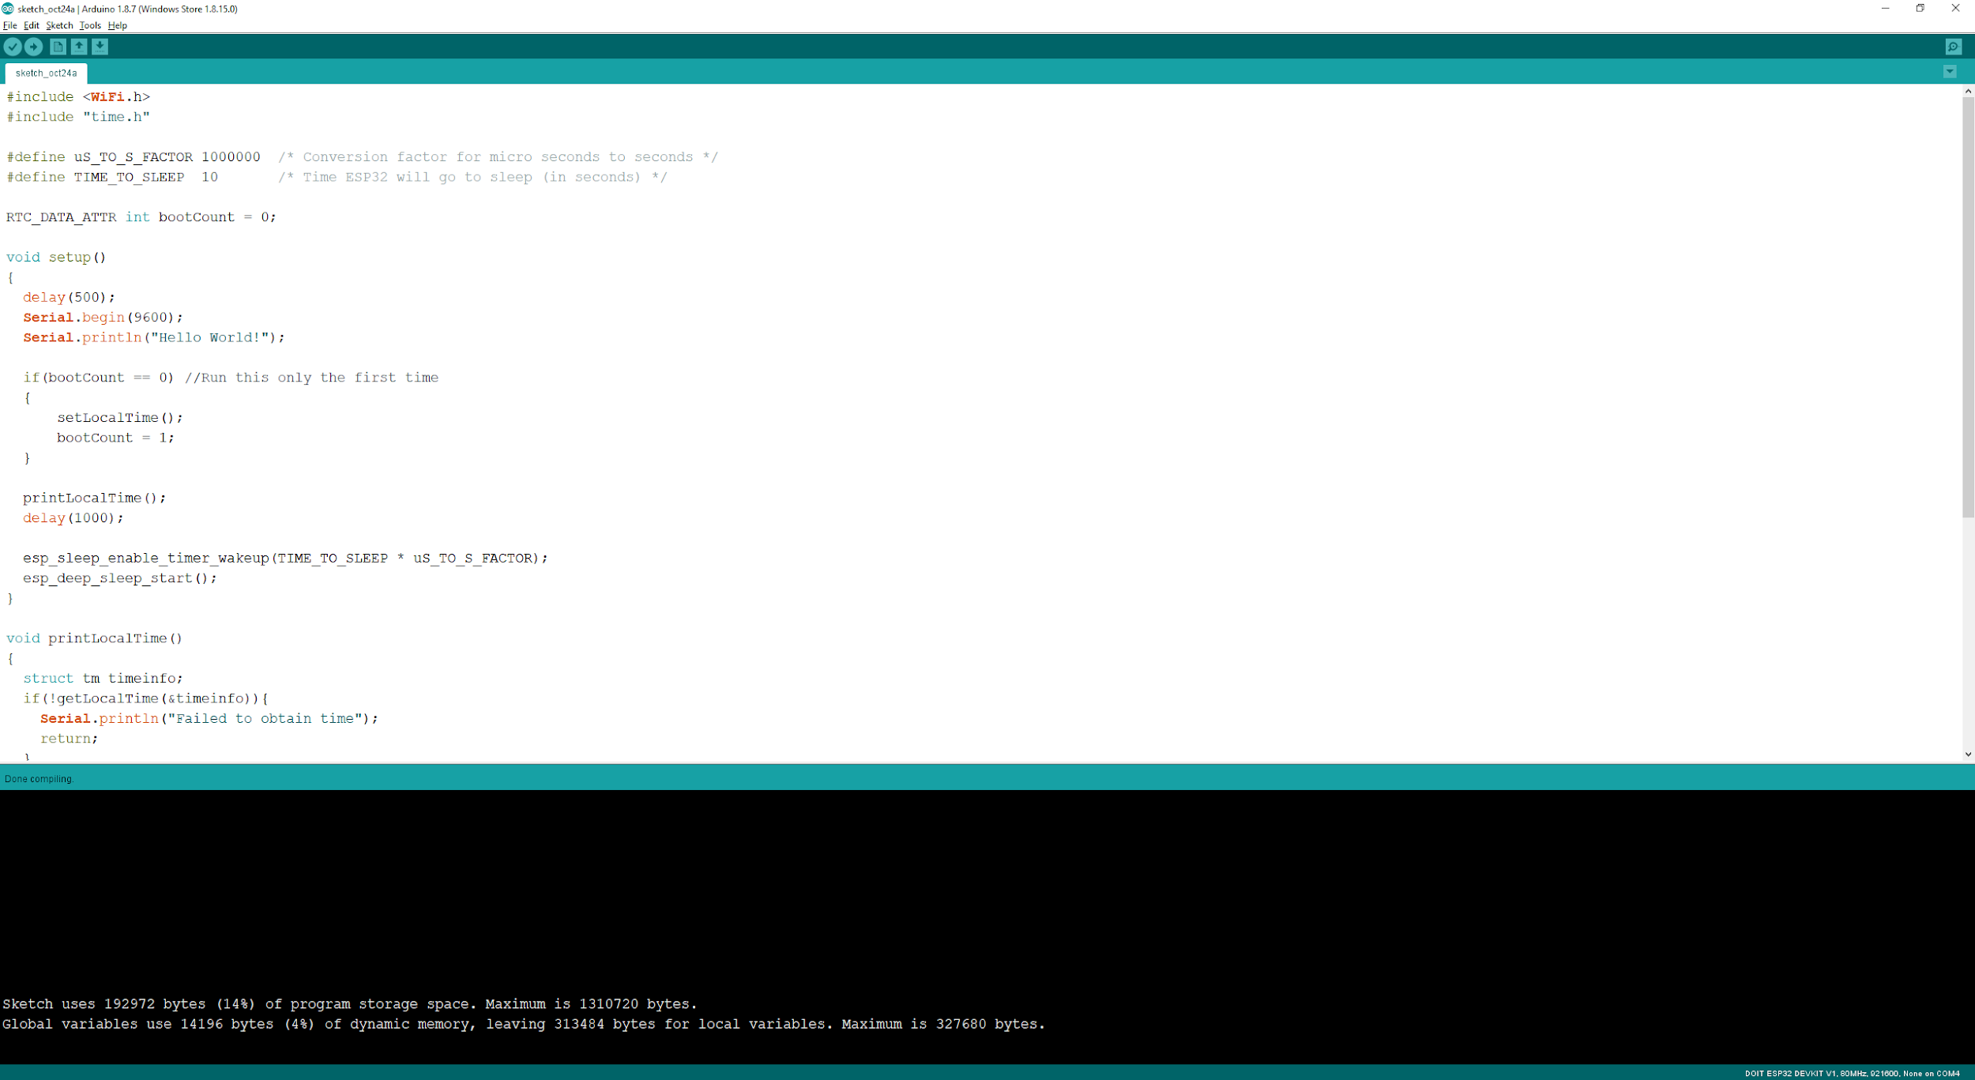
Arduino IDE
Notes:
Connect to microcontroller to the computer (USB). Start Arduino software. Select the (hopefully) correct port. Select the correct board (DOIT ESP-32)

Slide 23
Lesson 2

Slide 24
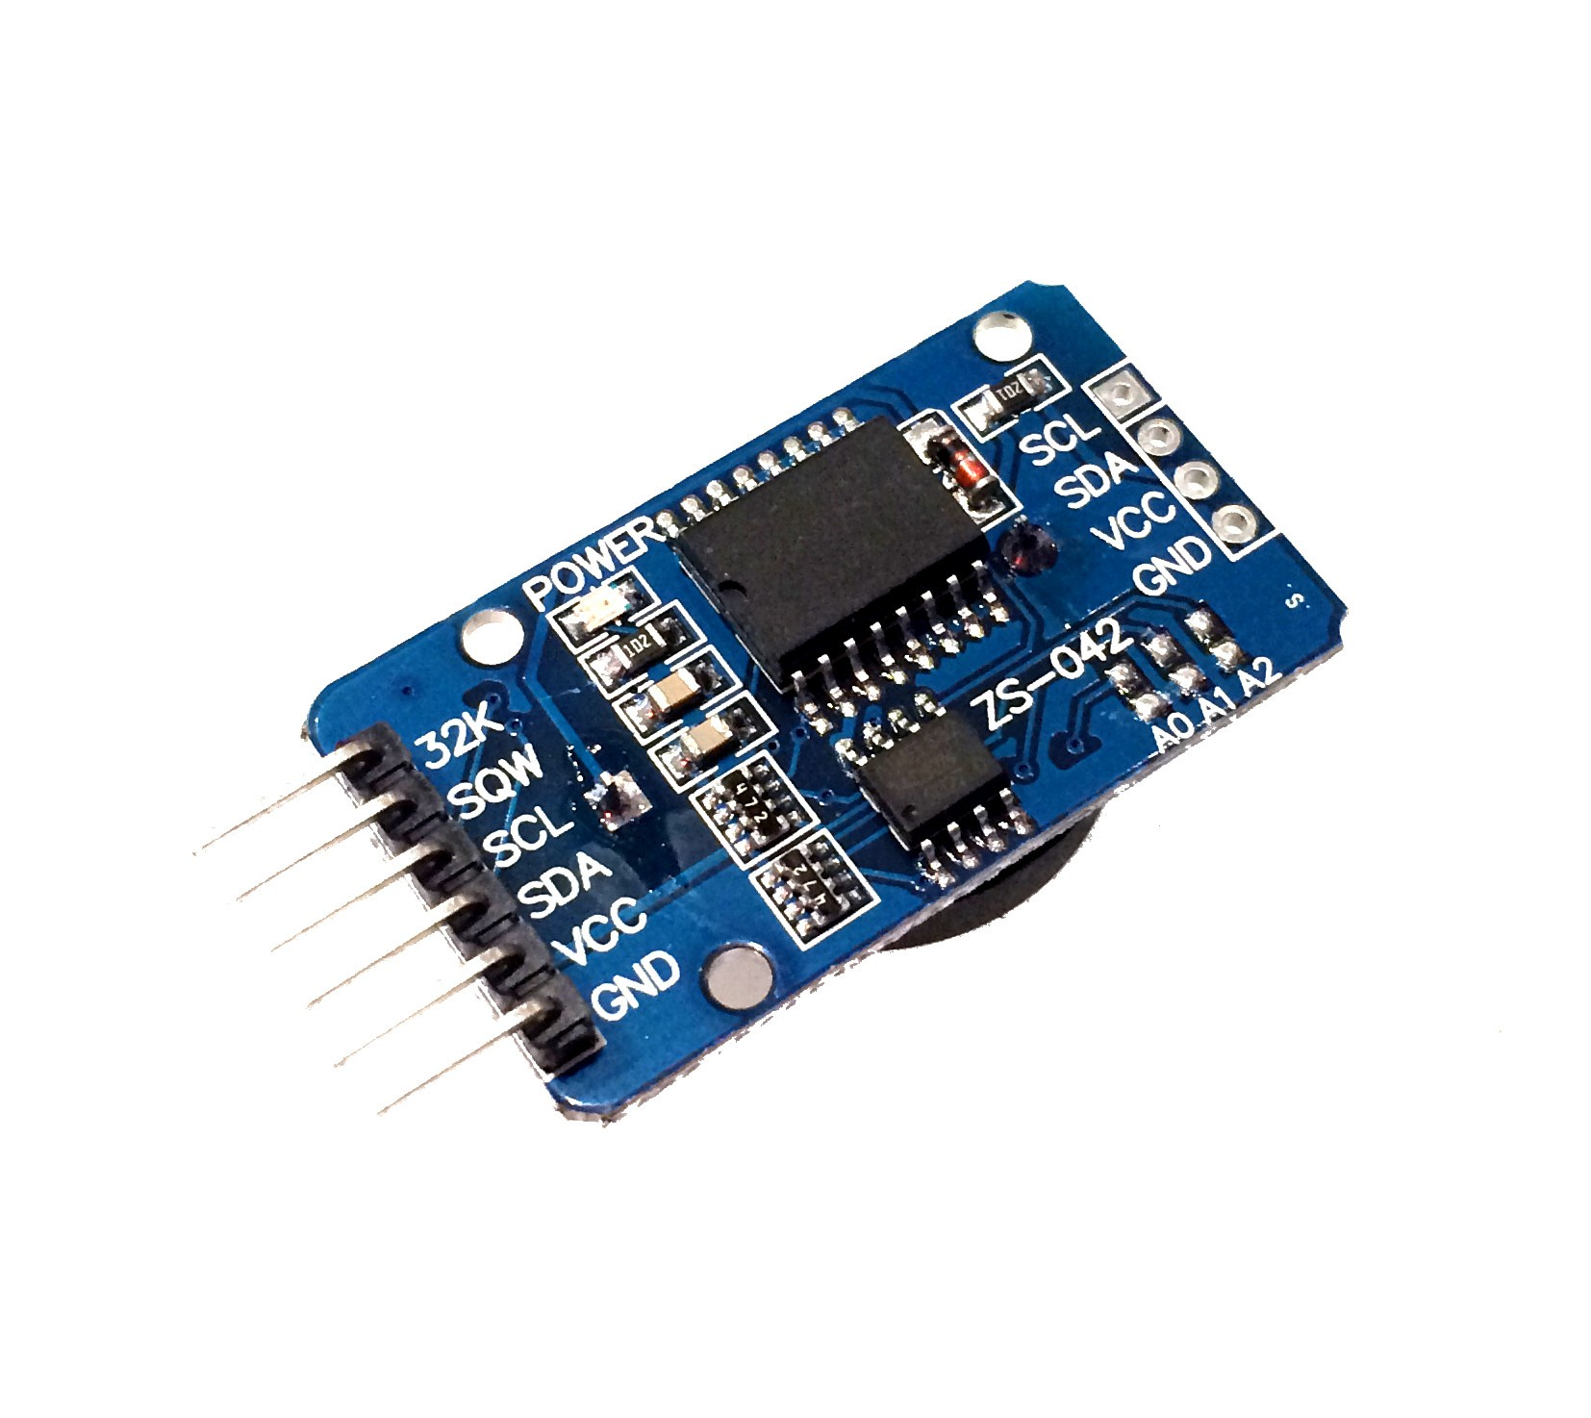
Real Time Clock
RTC DS3231
Flexible Power Requirements
Highly Accurate
Very Low Standby power consumption
Build-in very stable crystal oscillator.

Slide 25
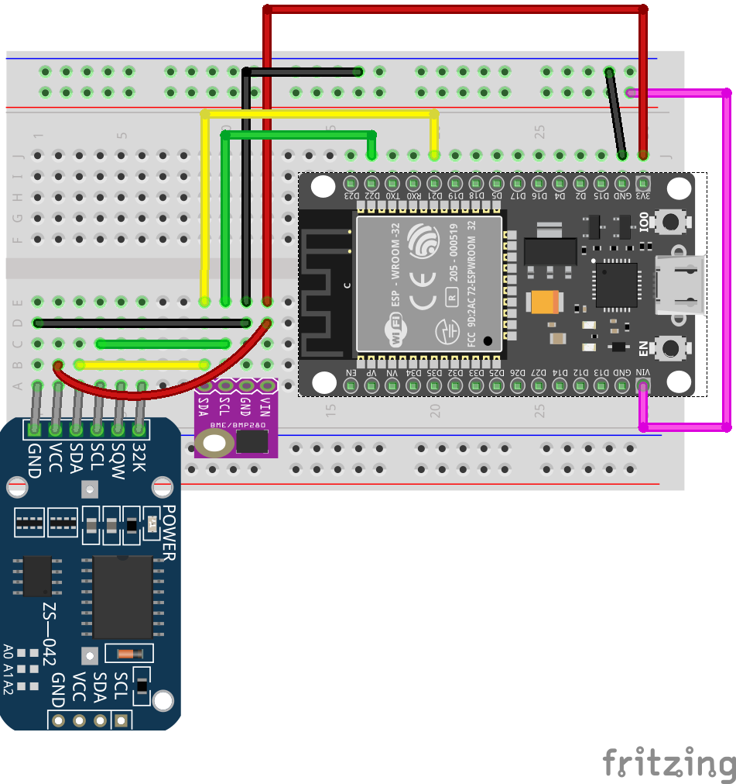
Add the RTC

Slide 26
Lesson 3

Slide 27
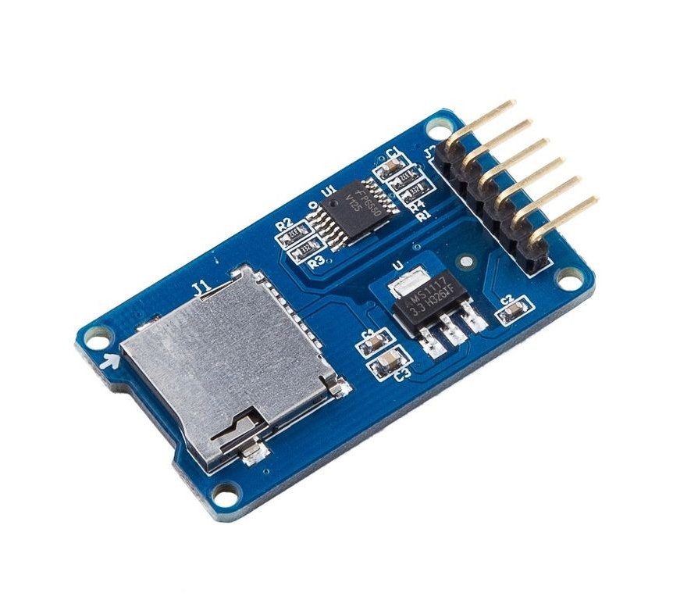
SD Card Reader/Writer
Micro SD Card Board
Accepts Micro SD cards
Common
Uses SPI

Slide 28
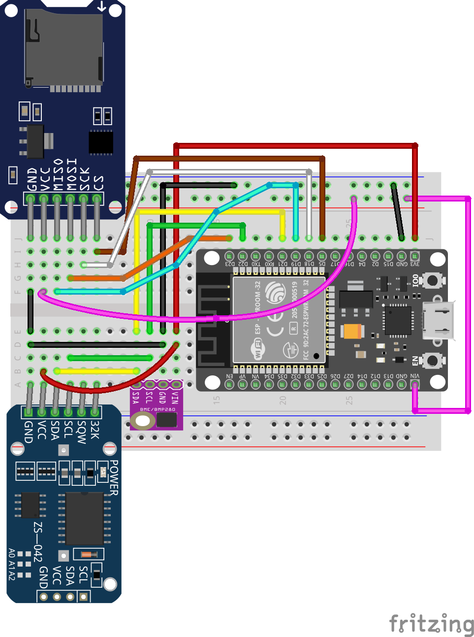
Add the SD Card

Slide 29
Wasn’t that fun?

